Slide 1
CZ2004 Hi-Fi
Ng Chi Hui (Seat 19, DSAI2)
Reviewer:
Melvin Tay Jun Wei (Seat 18)
Click here to Begin

Slide 2
Overview:
(A) New User
Guide
Rides (1)
Sign up
Dining (2)
Shows (3)
Shopping (4)
Add to Plan from Map
Tap for Direction + Back
Remove plan from map view
Add Plan from Detailed View + Back
Search Feature + Back
Navigation Bar to Planning Feature
Add new plan
Edit Plan
Drag and Drop Functionality
Undo and Redo
Discard & Save changes
Screensaver
(B) Returning User
Log In
View Plan
Change Language
Help
Annotation
Above diagram shows the high-level overview of the Hi-Fi prototype to allow you to explore the available features in a guided manner.
You may or may not follow the recommended path but it’s recommended for first time users to go through the sequence.
To help you find the clickable component, there will be a hand icon indicated. You may have to wait a while for the animation to load.
Enjoy!
Changes Made Following Evaluation
Included more design dialogs to yield closure such as the progress bar to show the number of steps left in the registration sequence and the start button.
Begin Exploring button added after sign up is performed.
Using a cross button to remove items from the plan.

Slide 3
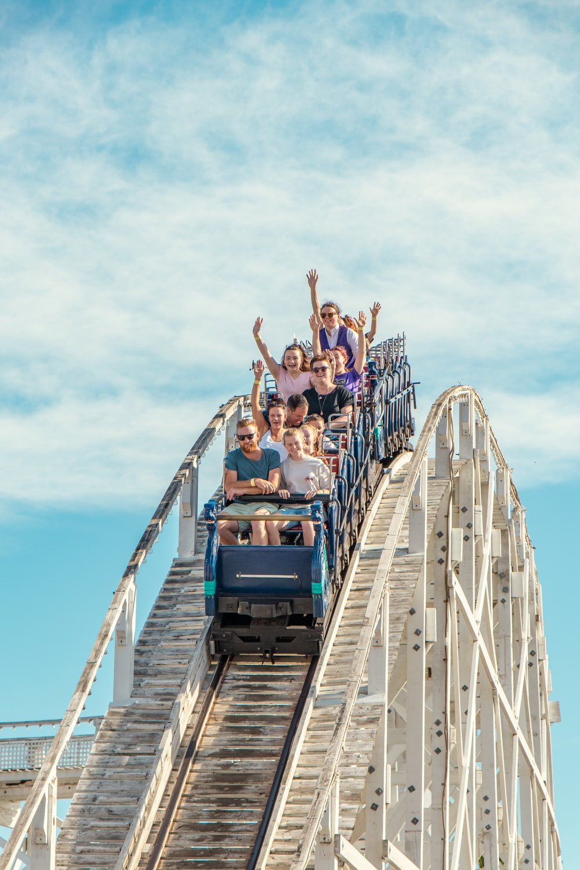




Today’s Park Hours: 9.00 a.m. to 10.00pm
Multiversal Studios
Express Pass Tickets on PROMOTION!
Get yours now at $68 ONLY(up $100)
Tap to Start
Guide
Help
Plan
Notes:
https://unsplash.com/photos/1zTxyQ3kMaQ

Slide 4
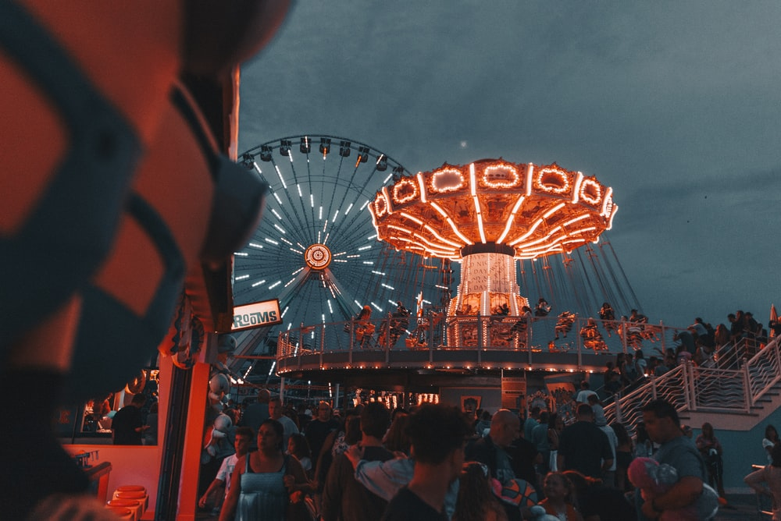
Today’s Park Hours: 9.00 a.m. to 10.00pm
Multiversal Studios
Sky Flyer Ride
Under Maintenance
Ride would be closed until further notice. Sorry for the inconvenience caused
Tap to Start
Guide
Help
Plan
Notes:
https://unsplash.com/photos/6pP4QXefjkg

Slide 5
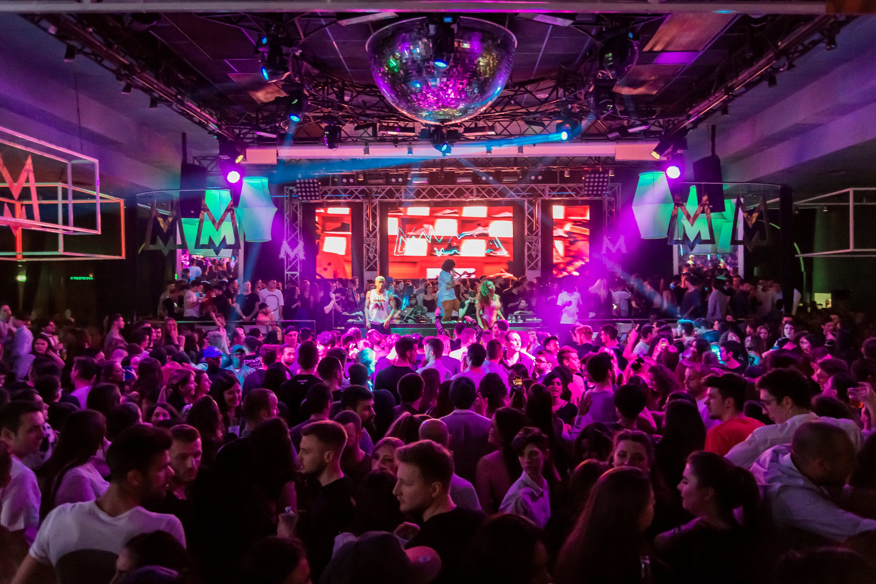
Today’s Park Hours: 9.00 a.m. to 10.00pm
Multiversal Studios
Coachella Musical Night
~Music & Arts Festival~
8pm - 12 Midnight
Tap to Start
Guide
Help
Plan
Notes:
https://unsplash.com/photos/6pP4QXefjkg

Slide 6






9
Sign Up Tutorial
Today’s Park Hours: 9.00 a.m. to 10.00pm
All group members must stand in front of the camera like the example shown below.
Multiversal Studios
Coachella Musical Night
~Music & Arts Festival~
Start
Guide
Help
Plan
Notes:
https://unsplash.com/photos/6pP4QXefjkg

Slide 7

9
Sign Up
Today’s Park Hours: 9.00 a.m. to 10.00pm
All group members must stand in front of the camera
Detection
Alignment
Registering
Multiversal Studios
Coachella Musical Night
~Music & Arts Festival~
30%
Detecting your face(s)…
Guide
Help
Plan
Notes:
https://unsplash.com/photos/6pP4QXefjkg

Slide 8



Sign Up
Today’s Park Hours: 9.00 a.m. to 10.00pm
All group members must stand in front of the camera
Detection
Alignment
Registered
Multiversal Studios
Coachella Musical Night
Shift to your left!
~Music & Arts Festival~
80%
Please keep your face(s) within the frame
Guide
Help
Plan
Notes:
https://unsplash.com/photos/6pP4QXefjkg

Slide 9



Sign Up
Today’s Park Hours: 9.00 a.m. to 10.00pm
Successfully Registered!
Detection
Alignment
Registered
Multiversal Studios
Coachella Musical Night
~Music & Arts Festival~
99%
Registered…
Add more
Begin Exploring
Guide
Help
Plan
Notes:
https://unsplash.com/photos/6pP4QXefjkg

Slide 10

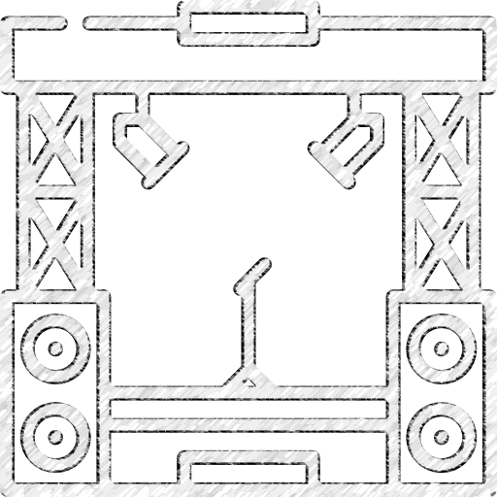



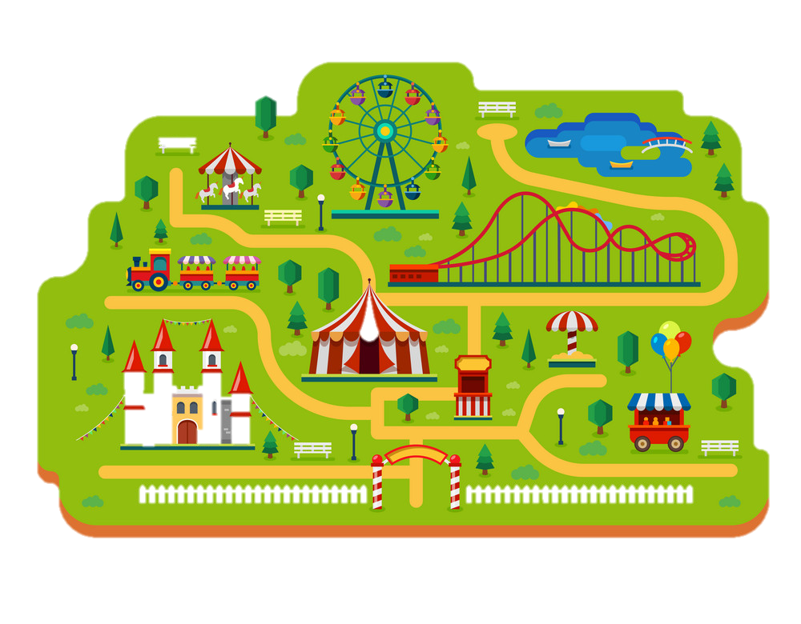

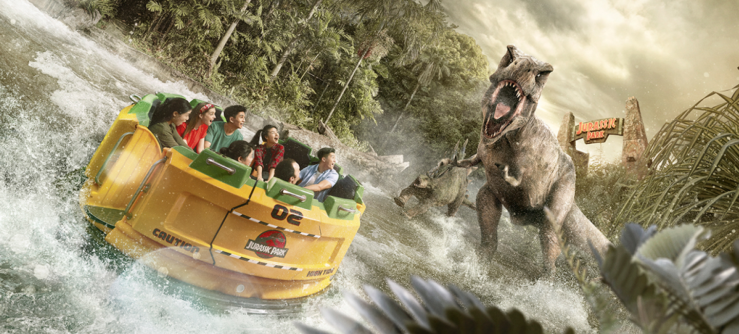









Guide
Rides
Shows
Dining
Shopping
Kids
Thrill
Water
Max Wait Time
Off
10min
90min
Rider Height
Tap for Details
Off
100cm
180cm
Clear
Hollywood RipTM
Tap for Direction
Pinch to Zoom
Gryffindor World
Add to plan
Hufflepuff
2 min
10 min
107m
Gryffindor
Slytherin
Ravenclaw
You are
Here

Slide 11

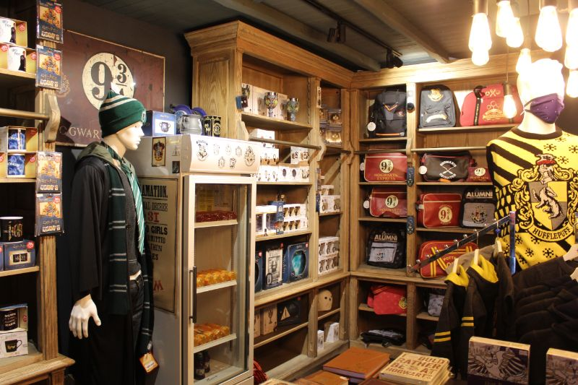


Guide
Rides
Shows
Dining
Shopping
Apparel
Collectibles
Games
Beauty
Clear
Pinch to Zoom
Gryffindor
Hufflepuff
The Apothecary
Ravenclaw World
Theme: Witches
2 min
10 min
Slytherin
Ravenclaw
You are
Here

Slide 12
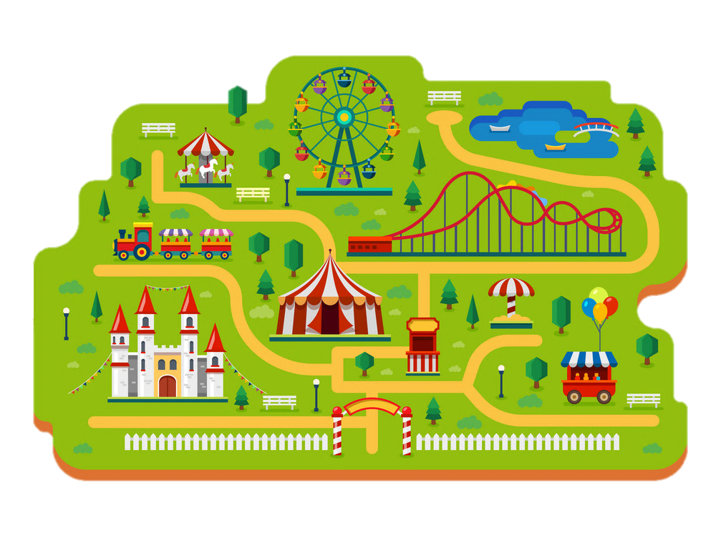

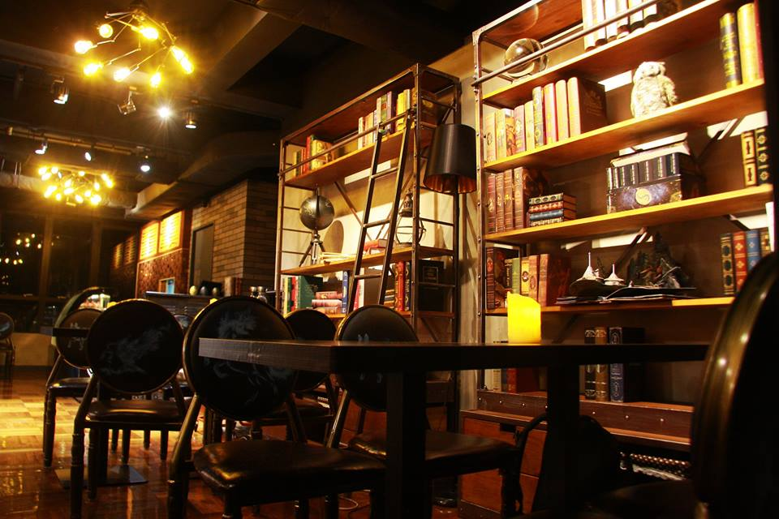






Guide
Rides
Shows
Dining
Shopping
Vegetarian
Vegan
Kosher
Halal
Clear
Pinch to Zoom
Gryffindor
Hufflepuff
Dobby Cafe
Hufflepuff World
3 min
40 min
Slytherin
Ravenclaw
You are
Here

Slide 13

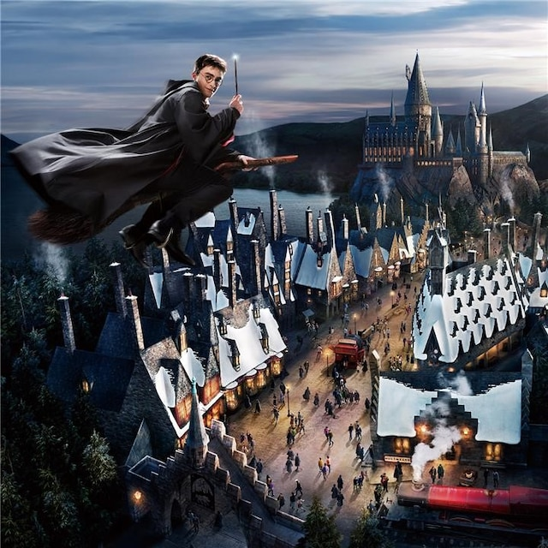


Guide
Rides
Shows
Dining
Shopping
Action
Music
Parade
Next show time
Off
10min
90min
Clear
Pinch to Zoom
Gryffindor
Hufflepuff
The Wizarding World
Slytherin World
Ravenclaw
5 min
You are
Here
Slytherin

Slide 14




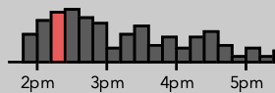



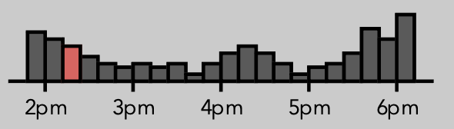


Dobby Cafe
Dobby Cafe
Dining
Directions
Added to Plan
Add to Plan
Attraction Description
Dobby Cafe
Hufflepuff World
Walking Time: 3 Min
Potterheads in the city now have a reason to rejoice! Come enjoy Harry-Potter-themed café, where one can experience the best of food and Harry Potter memorabilia.
Waiting Time: 40 Min
More Details
Halal Choice
Cuisine: Western
Healing Potions
Ron’s Orange Boost
Tongue Twisters
Burgers
The Muggle’s Choice
Steaks
The Half Blooded Steak
Crowd Levels: Medium
Halal Options Available
Vegetarian Options Available

Slide 15

Hollywood Rip
Rides
Directions
Added to Plan
Attraction Description
Hollywood RipTM
Gryffindor World
Walking Time: 2 Min
This ride is a water journey in a circular raft. The raft will suddenly accelerate, turn and drop. The movement of the raft is very dynamic and includes sudden tilting and jarring actions. Riders will get wet, possibly soaked.
Waiting Time: 10 Min
More Details
Children 107cm to 122cm in height must be
accompanied by a supervising companion.
Prosthetic limbs should be secured or removed to
prevent hazards or loss due to ride forces. Please see
a team member for assistance.
This ride employs a vertical lift system that riders with certain medical conditions may find claustrophobic.
The ride vehicle and restraints may not accommodate certain people due to their body shape or size.
TO RIDE, YOU SHOULD BE ABLE TO:
Continuously grasp the grab bar with at least one upper extremity; independently maintain yourself in an upright position.
Minimum Height: 107m
Crowd Levels
Notes:
Wording Credits to Universal Studio Singapore

Slide 16

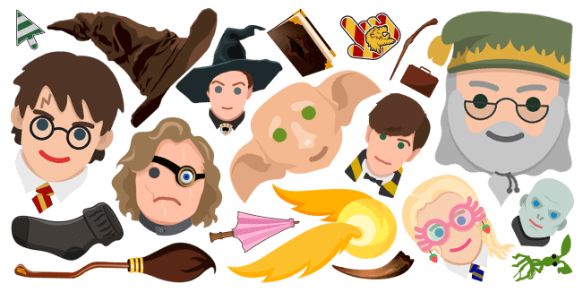
Wizarding World
Shows
Directions
Added to Plan
Attraction Description
The Wizarding WorldTM
Slytherin World
Walking Time: 5 Min
The Wizarding World of Harry Potter™ will reproduce the world from the Harry Potter™ stories, bringing it to life on a phenomenal scale. Don’t miss out! Here, you can fully immerse yourself in the world that you saw in the movies, and experience a truly extraordinary journey.
Show Timings:
10am 2pm 6pm 9pm
Theme: Harry Potter and
The Chamber of Secrets
Characters
More Details
Children under 122cm in height must be
accompanied by a supervising companion.
The show theatre has a chariot vehicle specially designed to remain in a standard wheelchair. Please see an attraction team member for further information and assistance.
Please be at the attraction at least 5 minutes before the start of the show.
TO ENJOY THE SHOW, YOU SHOULD BE ABLE TO:
Independently maintain yourself in an upright position.
Notes:
Picture Credits: https://www.usj.co.jp/web/en/us/areas/the-wizarding-world-of-harry-potter
\
https://custom-cursor.com/en/collection/harry-potter

Slide 17
The Apothecary
Shopping
Directions
Added to Plan
Attraction Description
The Apothecary
Ravenclaw World
Walking Time: 2 Min
Exciting toys, games and merchandise all from the world of harry potter. Bring home a piece of Harry Potter with you
Waiting Time: 10 Min
Theme: Witches
Crowd Levels
Notes:
https://bestthingstodoinyork.co.uk/harry-potter-york

Slide 18


Dobby Cafe
Dobby Cafe
Dining
Directions to Hollywood Rip
Rides
Walking Time: 5 min
Directions
Add to Plan
Attraction Description
Dobby Cafe
Hufflepuff World
Walking Time: 3 Min
Potterheads in the city now have a reason to rejoice! Come enjoy Harry-Potter-themed café, where one can experience the best of food and Harry Potter memorabilia.
Waiting Time: 40 Min
More Details
Halal Choice
Cuisine: Western
Healing Potions
Ron’s Orange Boost
Tongue Twisters
Burgers
The Muggle’s Choice
Steaks
The Half Blooded Steak
Crowd Levels: Medium
You are
Here
Halal Options Available
Vegetarian Options Available

Slide 19

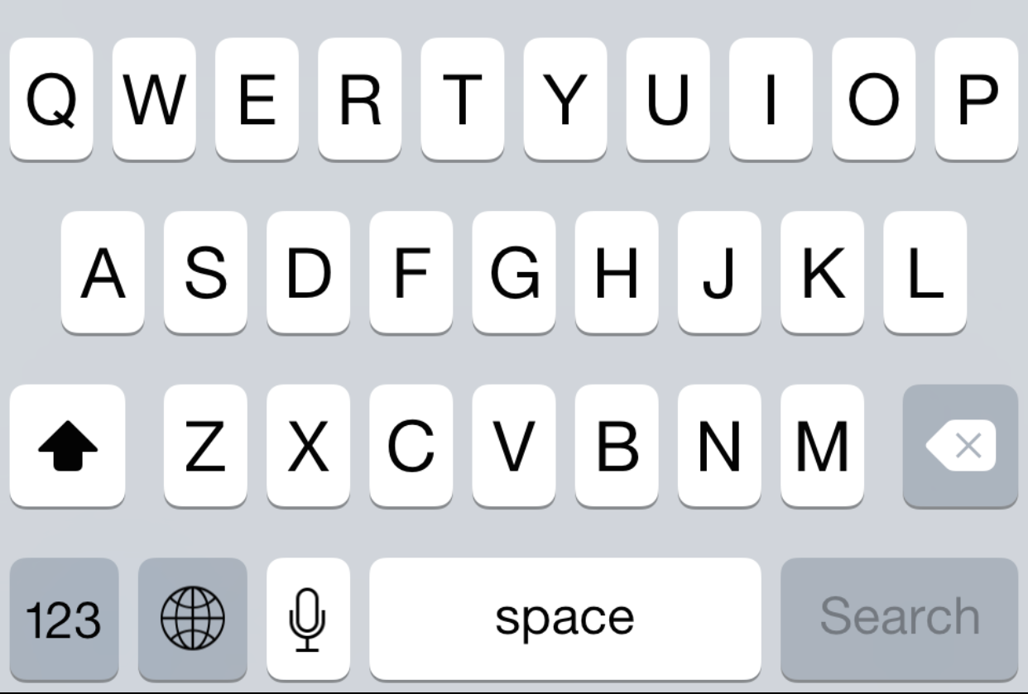
Search
Rides
Rides
Shows
Hollywood RipTM
Gryffindor World
Dining
This ride is a water journey in a circular raft. The raft will suddenly accelerate, turn and drop. The movement of the raft is very dynamic and includes sudden tilting and jarring actions. Riders will get wet, possibly soaked.
Shopping
Shows
Dining
Shopping
Holly

Slide 20






Bob’s Family
Park’s Hours
Guide
Rides
Shows
Dining
Shopping
Itinerary
Plan
Additional Information
Promotions
Amenities
Help

Slide 21
Bob’s Family
Park’s Hours
Guide
Rides
Shows
Dining
Shopping
Itinerary
Plan
Additional Information
Promotions
Amenities
Help

Slide 22

Additional
Information
Promotions
Amenities
Help
General FAQs
General FAQs
Do I need to be vaccinated to enter the attractions? Only fully vaccinated guests, children aged 12 and below, and guests who have either recovered from COVID-19 or have a valid negative pre-event test (PET) result may enter.
What is the maximum group size?
Where can I buy tickets?
Annual Season Pass
Others
Where can I buy tickets?
Annual Season Pass
Others

Slide 23
End of Stimulation for New User(s)
Begin stimulation for existing users
Stimulate Returning User
10am 2pm 6pm 9pm

Slide 24






Plan
Unplanned
Plan 1
2pm
The Apothecary
Ravenclaw World
Theme: Witches
2 min
10 min
3pm
Hollywood RipTM
Gryffindor World
2 min
10 min
4pm
No Plan
107m
Dobby Cafe
Hufflepuff World
6pm
3 min
40 min
The Wizarding World
Slytherin World
7pm
5 min
10am 2pm 6pm 9pm
New Plan
Edit

Slide 25
Plan
Unplanned
Plan 1
Plan 2
2pm
The Apothecary
Ravenclaw World
Theme: Witches
2 min
10 min
3pm
Hollywood RipTM
Gryffindor World
2 min
10 min
4pm
No Plan
107m
Dobby Cafe
Hufflepuff World
6pm
3 min
40 min
The Wizarding World
Slytherin World
7pm
5 min
10am 2pm 6pm 9pm
New Plan
Edit

Slide 26




Unplanned
Plan 1
Plan 2
2pm
The Apothecary
Ravenclaw World
Theme: Witches
2 min
10 min
3pm
Hollywood RipTM
Gryffindor World
2 min
10 min
4pm
No Plan
107m
Dobby Cafe
Hufflepuff World
6pm
3 min
40 min
The Wizarding World
Slytherin World
7pm
5 min
10am 2pm 6pm 9pm
Discard
Save

Slide 27
Plan
Unplanned
Plan 1
Plan 2
2pm
The Apothecary
Ravenclaw World
Theme: Witches
2 min
10 min
3pm
Hollywood RipTM
Gryffindor World
2 min
10 min
4pm
No Plan
107m
Dobby Cafe
Hufflepuff World
6pm
3 min
40 min
The Wizarding World
Slytherin World
7pm
5 min
10am 2pm 6pm 9pm
Discard
Save

Slide 28
Plan
Unplanned
Adult
Kids
2pm
The Apothecary
Ravenclaw World
Theme: Witches
The Apothecary
Ravenclaw World
2 min
10 min
Theme: Witches
3pm
2 min
10 min
Hollywood RipTM
Gryffindor World
2 min
10 min
4pm
No Plan
107m
Dobby Cafe
Hufflepuff World
6pm
3 min
40 min
The Wizarding World
Slytherin World
7pm
5 min
10am 2pm 6pm 9pm
10am 2pm 6pm 9pm
Discard
Save

Slide 29
Plan
Unplanned
Adult
Kids
2pm
The Apothecary
Ravenclaw World
Theme: Witches
The Apothecary
Ravenclaw World
2 min
10 min
Theme: Witches
3pm
2 min
10 min
Hollywood RipTM
Gryffindor World
Fast Forward >>
2 min
10 min
4pm
No Plan
107m
Dobby Cafe
Hufflepuff World
6pm
3 min
40 min
The Wizarding World
Slytherin World
7pm
5 min
10am 2pm 6pm 9pm
10am 2pm 6pm 9pm
Discard
Save

Slide 30
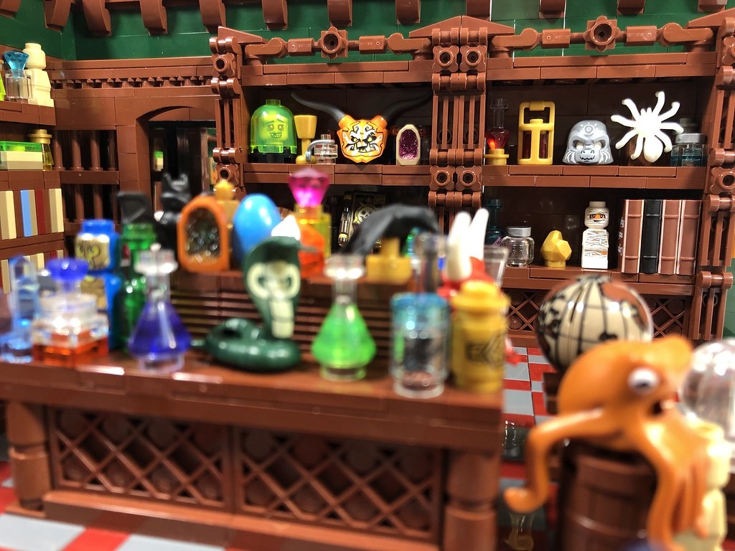

Plan
Unplanned
Adult
Kids
2pm
The Apothecary
Hollywood RipTM
Ravenclaw World
Gryffindor World
2 min
10 min
2p.m
–
2.45p.m
Theme: Witches
The Apothecary
107m
Ravenclaw World
Theme: Witches
2.30p.m–
3.00p.m
2 min
10 min
3pm
2 min
10 min
Hollywood RipTM
Gryffindor World
Dobby Cafe
Hufflepuff World
3.30p.m–
4.00p.m
2 min
10 min
4pm
3 min
40 min
107m
Dobby Cafe
Potion Shop
4.10p.m–
5.50p.m
Hufflepuff World
Hufflepuff World
Theme: Witches
2 min
10 min
6pm
3 min
40 min
The Wizarding World
6.00p.m–
6.30p.m
Slytherin World
5 min
The Wizarding World
10am 2pm 6pm 9pm
Slytherin World
7pm
5 min
10am 2pm 6pm 9pm
10am 2pm 6pm 9pm
Potion Shop
Hufflepuff World
Theme: Witches
Discard
Save
2 min
10 min

Slide 31
Unplanned
Kids
2pm
The Apothecary
Hollywood RipTM
Ravenclaw World
Gryffindor World
2 min
10 min
2p.m
–
2.45p.m
Theme: Witches
The Apothecary
107m
Ravenclaw World
Theme: Witches
2.30p.m–
3.00p.m
2 min
10 min
3pm
2 min
10 min
Hollywood RipTM
Gryffindor World
Dobby Cafe
3.30p.m–
4.00p.m
3.30p.m–
4.00p.m
Hufflepuff World
2 min
10 min
4pm
3 min
40 min
107m
Dobby Cafe
Potion Shop
4.10p.m–
5.50p.m
Hufflepuff World
Hufflepuff World
Theme: Witches
2 min
10 min
6pm
3 min
40 min
The Wizarding World
6.00p.m–
6.30p.m
Slytherin World
5 min
The Wizarding World
10am 2pm 6pm 9pm
Slytherin World
7pm
5 min
10am 2pm 6pm 9pm
10am 2pm 6pm 9pm
Potion Shop
Hufflepuff World
Theme: Witches
Discard
Save
2 min
10 min

Slide 32
Plan
Unplanned
Adult
Kids
2pm
The Apothecary
Hollywood RipTM
Ravenclaw World
Gryffindor World
2 min
10 min
2p.m
–
2.45p.m
Theme: Witches
The Apothecary
107m
Ravenclaw World
Theme: Witches
2.30p.m–
3.00p.m
2 min
10 min
3pm
2 min
10 min
Hollywood RipTM
Gryffindor World
Dobby Cafe
3.30p.m–
4.00p.m
3.30p.m–
4.00p.m
Hufflepuff World
2 min
10 min
4pm
3 min
40 min
107m
Dobby Cafe
Potion Shop
4.10p.m–
5.50p.m
Hufflepuff World
Hufflepuff World
Theme: Witches
2 min
10 min
6pm
3 min
40 min
The Wizarding World
6.00p.m–
6.30p.m
Slytherin World
5 min
The Wizarding World
10am 2pm 6pm 9pm
Slytherin World
7pm
5 min
10am 2pm 6pm 9pm
10am 2pm 6pm 9pm
Potion Shop
Hufflepuff World
Theme: Witches
Discard
Save
2 min
10 min

Slide 33
Plan
Unplanned
Adult
Kids
2pm
The Apothecary
Hollywood RipTM
Ravenclaw World
Gryffindor World
2 min
10 min
2p.m
–
2.45p.m
Theme: Witches
The Apothecary
107m
Ravenclaw World
Theme: Witches
2.30p.m–
3.00p.m
2 min
10 min
3pm
2 min
10 min
Hollywood RipTM
Gryffindor World
Dobby Cafe
3.30p.m–
4.00p.m
3.30p.m–
4.00p.m
Hufflepuff World
2 min
10 min
4pm
3 min
40 min
107m
Dobby Cafe
Potion Shop
4.10p.m–
5.50p.m
Hufflepuff World
Hufflepuff World
Theme: Witches
2 min
10 min
6pm
3 min
40 min
The Wizarding World
6.00p.m–
6.30p.m
Slytherin World
5 min
The Wizarding World
10am 2pm 6pm 9pm
Slytherin World
7pm
5 min
10am 2pm 6pm 9pm
10am 2pm 6pm 9pm
Potion Shop
Hufflepuff World
Theme: Witches
Discard
Save
2 min
10 min

Slide 34


Plan
Unplanned
Adult
Kids
2pm
The Apothecary
Hollywood RipTM
Ravenclaw World
Gryffindor World
The Apothecary
2 min
10 min
107m
Theme: Witches
Ravenclaw World
2 min
10 min
Theme: Witches
3pm
2 min
10 min
Hollywood RipTM
Gryffindor World
Dobby Cafe
Discard Changes?
Hufflepuff World
2 min
10 min
4pm
3 min
40 min
107m
Are you sure you want to discard all your changes to the plans?
Potion Shop
Dobby Cafe
Hufflepuff World
Hufflepuff World
Theme: Witches
2 min
10 min
6pm
Delete
Cancel
3 min
40 min
The Wizarding World
Slytherin World
5 min
The Wizarding World
10am 2pm 6pm 9pm
Slytherin World
7pm
5 min
10am 2pm 6pm 9pm
Potion Shop
Hufflepuff World
Theme: Witches
Discard
Save
2 min
10 min

Slide 35
Plan
Unplanned
Adult
Kids
2pm
The Apothecary
Hollywood RipTM
Ravenclaw World
Gryffindor World
The Apothecary
2 min
10 min
107m
Theme: Witches
Ravenclaw World
2 min
10 min
Theme: Witches
3pm
2 min
10 min
Hollywood RipTM
Gryffindor World
Dobby Cafe
Hufflepuff World
2 min
10 min
4pm
3 min
40 min
107m
Save Changes?
Dobby Cafe
Potion Shop
Hufflepuff World
Hufflepuff World
Theme: Witches
2 min
10 min
6pm
Yes
No
3 min
40 min
The Wizarding World
Slytherin World
5 min
The Wizarding World
10am 2pm 6pm 9pm
Slytherin World
7pm
5 min
10am 2pm 6pm 9pm
Potion Shop
Hufflepuff World
Theme: Witches
Discard
Save
2 min
10 min

Slide 36

Plan
Unplanned
Adult
Kids
2pm
The Apothecary
Hollywood RipTM
Ravenclaw World
Gryffindor World
The Apothecary
2 min
10 min
107m
Theme: Witches
Ravenclaw World
2 min
10 min
Theme: Witches
3pm
2 min
10 min
Hollywood RipTM
Gryffindor World
Dobby Cafe
Hufflepuff World
Please Wait…
2 min
10 min
4pm
3 min
40 min
107m
Dobby Cafe
Potion Shop
Hufflepuff World
85%
Hufflepuff World
Theme: Witches
Still Saving…
2 min
10 min
6pm
3 min
40 min
The Wizarding World
Cancel
Slytherin World
5 min
The Wizarding World
10am 2pm 6pm 9pm
Slytherin World
7pm
5 min
10am 2pm 6pm 9pm
Potion Shop
Hufflepuff World
Theme: Witches
Cancel
Save
2 min
10 min

Slide 37

Plan
Unplanned
Adult
Kids
2pm
The Apothecary
Hollywood RipTM
Ravenclaw World
Gryffindor World
The Apothecary
2 min
10 min
107m
Theme: Witches
Ravenclaw World
2 min
10 min
Theme: Witches
3pm
2 min
10 min
Hollywood RipTM
Gryffindor World
Dobby Cafe
Hufflepuff World
Success
2 min
10 min
4pm
3 min
40 min
107m
Dobby Cafe
Potion Shop
Hufflepuff World
Your plan has been successfully saved!
Hufflepuff World
Theme: Witches
2 min
10 min
6pm
3 min
40 min
The Wizarding World
Slytherin World
5 min
The Wizarding World
10am 2pm 6pm 9pm
Slytherin World
7pm
5 min
10am 2pm 6pm 9pm
Potion Shop
Hufflepuff World
Theme: Witches
Cancel
Save
2 min
10 min

Slide 38
Plan
Unplanned
Adult
Kids
2pm
The Apothecary
Hollywood RipTM
Ravenclaw World
Gryffindor World
2 min
10 min
2p.m
–
2.45p.m
Theme: Witches
The Apothecary
107m
Ravenclaw World
Theme: Witches
2.30p.m–
3.00p.m
2 min
10 min
3pm
2 min
10 min
Hollywood RipTM
Gryffindor World
Dobby Cafe
3.30p.m–
4.00p.m
3.30p.m–
4.00p.m
Hufflepuff World
2 min
10 min
4pm
3 min
40 min
107m
Dobby Cafe
Potion Shop
4.10p.m–
5.50p.m
Hufflepuff World
Hufflepuff World
Theme: Witches
2 min
10 min
6pm
3 min
40 min
The Wizarding World
6.00p.m–
6.30p.m
Slytherin World
5 min
The Wizarding World
10am 2pm 6pm 9pm
Slytherin World
7pm
5 min
10am 2pm 6pm 9pm
10am 2pm 6pm 9pm
Potion Shop
Hufflepuff World
Theme: Witches
New Plan
Edit
2 min
10 min

Slide 39
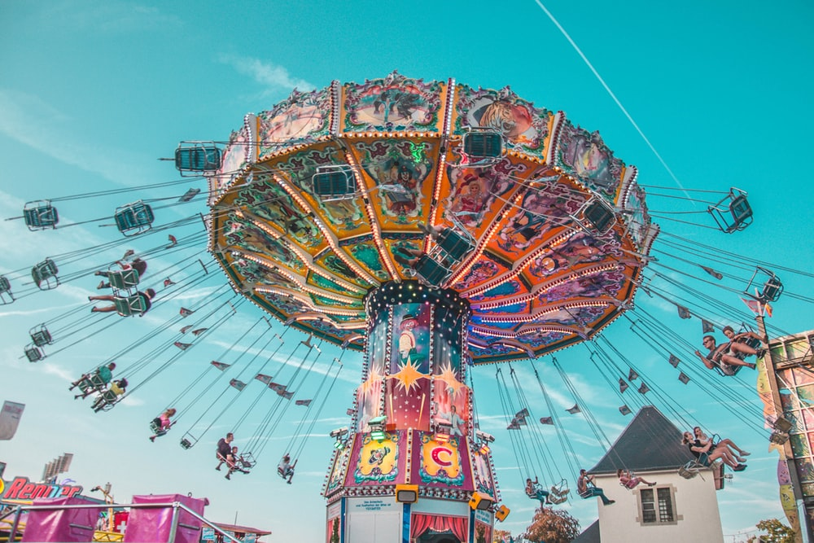
Today’s Park Hours: 9.00 a.m. to 10.00pm
Multiversal Studios
New Ride Flying Swing now Opened!
Mastercard Exclusive: Multiversal Studios Buy 2 get 1 Free Adult One-Day Ticket at SGD138
Tap to Start
Guide
Help
Plan
Notes:
https://unsplash.com/photos/o4E_qIyBj3k

Slide 40
Time: 1.20p.m
Today’s Park Hours: 9.00 a.m. to 10.00pm
You are signed in! Welcome back
Multiversal Studios
Coachella Musical Night
~Music & Arts Festival~
Close
Guide
Help
Plan
Notes:
https://unsplash.com/photos/6pP4QXefjkg

Slide 41
Plan
Unplanned
Adult
Kids
2pm
The Apothecary
Hollywood RipTM
Ravenclaw World
Gryffindor World
2 min
10 min
2p.m
–
2.45p.m
Theme: Witches
The Apothecary
107m
Ravenclaw World
Theme: Witches
2.30p.m–
3.00p.m
2 min
10 min
3pm
2 min
10 min
Hollywood RipTM
Gryffindor World
Dobby Cafe
3.30p.m–
4.00p.m
3.30p.m–
4.00p.m
Hufflepuff World
2 min
10 min
4pm
3 min
40 min
107m
Dobby Cafe
Potion Shop
4.10p.m–
5.50p.m
Hufflepuff World
Hufflepuff World
Theme: Witches
2 min
10 min
6pm
3 min
40 min
The Wizarding World
6.00p.m–
6.30p.m
Slytherin World
5 min
The Wizarding World
10am 2pm 6pm 9pm
Slytherin World
7pm
5 min
10am 2pm 6pm 9pm
10am 2pm 6pm 9pm
Stimulate Returning User
Potion Shop
Hufflepuff World
Theme: Witches
New Plan
Edit
2 min
10 min

Slide 42
Plan
Unplanned
Adult
Delayed. Longer Waiting Times
Kids
2pm
The Apothecary
Hollywood RipTM
Ravenclaw World
Under Maintenance
Gryffindor World
2 min
10 min
2p.m
–
3.00p.m
Theme: Witches
The Apothecary
107m
Ravenclaw World
Theme: Witches
2.30p.m–
3.00p.m
2 min
10 min
3pm
2 min
10 min
Hollywood RipTM
Gryffindor World
Dobby Cafe
3.30p.m–
4.00p.m
3.30p.m–
4.00p.m
Hufflepuff World
2 min
10 min
4pm
3 min
40 min
107m
Dobby Cafe
Potion Shop
4.10p.m–
5.50p.m
Hufflepuff World
Hufflepuff World
Theme: Witches
2 min
10 min
6pm
3 min
40 min
The Wizarding World
6.00p.m–
6.30p.m
Slytherin World
5 min
The Wizarding World
10am 2pm 6pm 9pm
Slytherin World
7pm
5 min
10am 2pm 6pm 9pm
10am 2pm 6pm 9pm
Potion Shop
Hufflepuff World
Theme: Witches
New Plan
Edit
2 min
10 min

Slide 43




Plan
Chinese
Unplanned
German
Bulgarian
Adult
Delayed. Longer Waiting Times
Kids
2pm
The Apothecary
French
Ravenclaw World
Under Maintenance
Hollywood RipTM
Gryffindor World
2 min
10 min
2p.m
–
3.00p.m
Theme: Witches
The Apothecary
107m
Ravenclaw World
Theme: Witches
2.30p.m–
3.00p.m
2 min
10 min
3pm
2 min
10 min
Hollywood RipTM
Gryffindor World
Dobby Cafe
3.30p.m–
4.00p.m
3.30p.m–
4.00p.m
Hufflepuff World
2 min
10 min
4pm
3 min
40 min
107m
Dobby Cafe
Potion Shop
4.10p.m–
5.50p.m
Hufflepuff World
Hufflepuff World
Theme: Witches
2 min
10 min
6pm
3 min
40 min
The Wizarding World
6.00p.m–
6.30p.m
Slytherin World
5 min
The Wizarding World
10am 2pm 6pm 9pm
Slytherin World
7pm
5 min
10am 2pm 6pm 9pm
10am 2pm 6pm 9pm
Potion Shop
Hufflepuff World
Theme: Witches
New Plan
Edit
2 min
10 min

Slide 44
规划
未·策划
成人
延迟。预期要更长的等候时间！
Kids
2pm
The Apothecary
Hollywood RipTM
Ravenclaw World
在维修中
Gryffindor World
2 min
10 min
2p.m
–
3.00p.m
Theme: Witches
The Apothecary
107m
Ravenclaw World
Theme: Witches
2.30p.m–
3.00p.m
2 min
10 min
3pm
2 min
10 min
Hollywood RipTM
Gryffindor World
Dobby Cafe
3.30p.m–
4.00p.m
3.30p.m–
4.00p.m
Hufflepuff World
2 min
10 min
4pm
3 min
40 min
107m
Dobby Cafe
Potion Shop
4.10p.m–
5.50p.m
Hufflepuff World
Hufflepuff World
Theme: Witches
2 min
10 min
6pm
3 min
40 min
The Wizarding World
6.00p.m–
6.30p.m
Slytherin World
5 min
The Wizarding World
10am 2pm 6pm 9pm
Slytherin World
7pm
5 min
10am 2pm 6pm 9pm
10am 2pm 6pm 9pm
Potion Shop
Hufflepuff World
Theme: Witches
新规划
更改
2 min
10 min

Slide 45
Plan
Unplanned
Adult
Kids
The Apothecary
2pm
Hollywood RipTM
Ravenclaw World
Gryffindor World
2 min
10 min
2p.m
–
2.45p.m
Theme: Witches
The Apothecary
107m
Ravenclaw World
Theme: Witches
2.30p.m–
3.00p.m
2 min
10 min
2 min
10 min
3pm
Hollywood RipTM
Gryffindor World
End of Stimulation for Returning User(s)
Dobby Cafe
3.30p.m–
4.00p.m
3.30p.m–
4.00p.m
Hufflepuff World
2 min
10 min
3 min
40 min
107m
4pm
Dobby Cafe
Potion Shop
4.10p.m–
5.50p.m
Hufflepuff World
Hufflepuff World
Theme: Witches
2 min
10 min
6pm
The Wizarding World
3 min
40 min
Slytherin World
6.00p.m–
6.30p.m
5 min
The Wizarding World
10am 2pm 6pm 9pm
Slytherin World
7pm
5 min
10am 2pm 6pm 9pm
10am 2pm 6pm 9pm
Potion Shop
Hufflepuff World
Theme: Witches
New Plan
Edit
2 min
10 min

Slide 46

THANK YOU!
Thank you for reviewing my Hi-Fi Prototype! Have a nice day!

